Slide 1
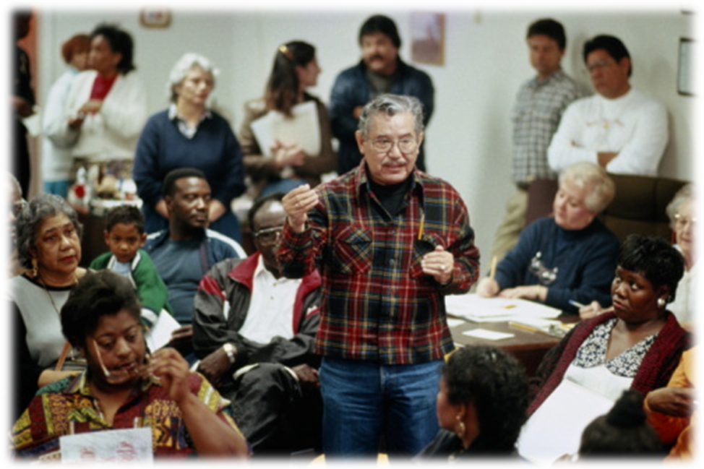
YEAR 1 2016-2017
FAMILY AND COMMUNITY
ENGAGEMENT
CHARTER PROJECT
SPONSOR: Lori Matway, Associate Superintendent Student Services
PROJECT MANAGER: Valerie Brimm, Director Office Of Strategic Partnerships

Slide 2
The State of the Family
The family is the cornerstone of our society. More than any other force it shapes the attitude, the hopes, the ambitions, and the values of the child. And when the family collapses it is the children that are usually damaged. When it happens on a massive scale the community itself is crippled. So, unless we work to strengthen the family, to create conditions under which most parents will stay together, all the rest---schools, playgrounds, and public assistance, and private concerns– will never be enough. Lyndon B. Johnson

Slide 3
Strategic Measures
Goal 1
Increase student achievement resulting in improvements for each school’s learning gains, grade level proficiency rates, graduation rates, and school grade designations of A, B or C.
Goal 4
Provide equity and excellence of education by increasing overall performance and eliminating the gaps between minority and non-minority student outcomes by reducing the disparity in graduation rates, proficiency scores on assessments, participation and performance in accelerated courses, disciplinary infractions, and placement in Exceptional Student Education programs.

Slide 4
Project Description
The Family and Community Engagement Project is designed to: (1) increase the number of family engagement events linked to learning, (2) establish systems of support for students, families and schools, (3) provide resources to strengthen students, schools, families and communities, and (4) develop a systemic way of work to embrace and
co-partner with our community stakeholders.

Slide 5
TARGETED RESULTS
(DESIRED OUTCOMES)
Every school has a family engagement team.
All family engagement activities are result –oriented versus event-oriented.
A sustainable infrastructure is in place to provide tools and resources to our families to support student learning.
A developed organizational system of community integration by which all stakeholders are integral partners in student learning.
A monitoring and accountability system in place to determine effective engagement between families, community and school staff.

Slide 6
LOGIC MODEL
Situation/Problem to
Be Solved
SITUATION/PROBLEM
INPUTS
Outputs
Activities Participation
1. Family Engagement activities
are event oriented rather
than result oriented.
Families lack the tools necessary to support their child’s learning.
Fragmented community partnerships lead to missed opportunities and underutilized services.
Lack of trust between families/community and the district.
District Staff
School staff
Money
Materials
Partners
Equipment
Resources
Time
Volunteers
Continue to implement Dr. Karen Mapp
Workshops
Continue monitoring engagement activities in Transformation Zone
schools by 50%
Family Engagement School guide developed and distributed to all schools.
School-based staff trained in family engagement strategies
Continue to work with community agencies to provide resources for families and communities
Implement restorative circles for family engagement activities.
Implement restorative practice to engage families and community
Students
Families
School Staff
District Staff
Community partners

Slide 7
LOGIC MODEL
Outcomes – Impact
Short Term Medium Term Long Term
Changing how family engagement is viewed and how staff can embrace families Develop system of engagement of community members, examples forums, surveys, input, etc. Opportunities identified for streamlined approach to service delivery and community outreach | FE becoming systemic Schools environments become more welcoming Relationships develop between schools and families Capacity is built for both school staff and families to embrace and build FE opportunities Collaboration between District and community agencies for services to support families | Student academic success is positively impacted FE is integrated and sustainable Families and schools are true co-partners Barriers to learning are removed as necessary tools and resources are easily provided to students and families Integrated systems of Community groups/agencies/

Slide 8
All school staff/community members will be trained in the Dual-Capacity Framework for Family and Community Engagement (Mapp).
Schools’ family engagement plans will be developed, reviewed, and implemented by District and action teams.
Community agencies and organizations will collaborate with the District to provide tools and resources for students, schools, and families.
Community outreach efforts for input, collaboration, and transparency will be systemized.
DELIVERABLES

Slide 9
PROJECT SUMMARY
Role | Description | Assignment
Sponsor (member of Executive Staff) | Has ultimate authority over and is responsible for a project and/or a program, its scope and deliverables. | Lori Matway, Associate Superintendent of Student Services
Project Manager | Develops and maintains project plan and project schedules, executes project reviews, tracks and disposes of issues and change requests, manages the budget, and is responsible for overall quality of the deliverables. | Valerie Brimm, Director of Strategic Partnerships Sheila Kane, Family and Community Area Coordinator
Project Team | Is responsible for performing the activities necessary for implementation of the project. | Valerie Brimm Sheila Kane Dr. Grant Brittany Daniels Johnetta Haugabrook Merlande Petitbois Natasha Karac Sandra Hopkins Shana Rafalski Former Mayor David Archie
Key Stakeholders | Provides expert understanding of their organization, and represents area for which the project is intended to support/serve. | Pinellas County School Executive Leadership Team

